Slide 1
Chapter 8
Innovative EC Systems:
From E-Government and E-Learning to Consumer-to-Consumer Commerce

Slide 2
Learning Objectives
Describe various e-government initiatives.
Describe e-learning, virtual universities, and e-training.
Describe online publishing and e-books.
Discuss wikis and blogging.
Describe knowledge management and dissemination as an e-business.
Describe C2C activities.
Describe peer-to-peer networks and applications.

Slide 3
E-Government: An Overview
e-government
E-commerce model in which a government entity buys or provides goods, services, or information to businesses or individual citizens

Slide 4
E-Government: An Overview
Several major categories fit within this broad definition of e-government:
  government-to-citizens (G2C)
  E-government category that includes all the interactions between a government and its citizens
  Government-to-business (G2B)
  Government-to-government (G2G)
  Internal Efficiency and Effectiveness (IEE)
  Government-to-employees (G2E)

Slide 5
E-Government: An Overview
government-to-citizens (G2C)
E-government category that includes all the interactions between a government and its citizens
electronic voting
Voting process that involves many steps ranging from registering, preparing, voting, and counting (voting and counting are all done electronically)
Netizen
A citizen surfing the Internet
Electronic benefits transfer

Slide 6
E-Government: An Overview
government-to-business (G2B)
E-government category that includes interactions between governments and businesses (government selling to businesses and providing them with services and businesses selling products and services to government)

Slide 7
E-Government: An Overview
Government-to-Business (G2B)
  Government e-procurement
  Group purchasing
  Forward e-auctions
  Tax collection and management

Slide 8
E-Government: An Overview
government-to-government (G2G)
E-government category that includes activities within government units and those between governments
government-to-employees (G2E)
E-government category that includes activities and services between government units and their employees

Slide 9
E-Government: An Overview
Government-to-Employees (G2E)
  Internal efficiency and effectiveness
    E-payroll
    E-records management
    E-training
    Enterprise case management
    Integrated acquisition
    Integrated human resources
    One-stop recruitment
Facilitating Homeland Security

Slide 10
Implementing E-Government
Six stages in the transformation to
e-government:
  Information publishing/dissemination
  “Official” two-way transactions with one department at a time
  Multipurpose portals
  Portal personalization
  Clustering of common services
  Full integration and enterprise transformation

Slide 11
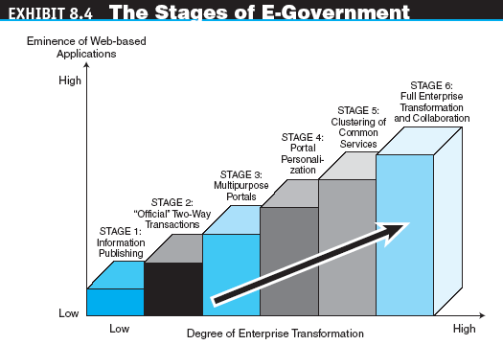
Implementing E-Government

Slide 12
Implementing E-Government
Implementation Issues of E-Government
  Transformation speed
  G2B implementation
  Security and privacy issues
  Wireless applications
  Business aspects
Citizen Adoption of E-Government
Non–Internet E-Government

Slide 13
E-Learning
e-learning
The online delivery of information for purposes of education, training, or knowledge management

Slide 14
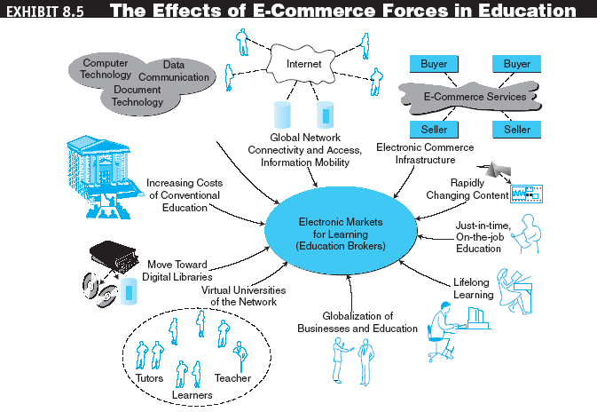
E-Learning

Slide 15
E-Learning
Benefits of E-Learning
  Time reduction
  Large volume and diversity
  Cost reduction
  Higher content retention
  Flexibility
  Updated and consistent material
  Fear-free environment

Slide 16
E-Learning
Drawbacks and Challenges of
E-Learning
  Need for instructor retraining
  Equipment needs and support services
  Lack of face-to-face interaction and campus life
  Assessment
  Maintenance and updating
  Protection of intellectual property
  Computer literacy
  Student retention

Slide 17
E-Learning
Why E-Learning Fails
  Believing that e-learning is always a cheaper learning or training alternative
  Overestimating what e-learning can accomplish
  Overlooking the shortcomings of self-study
  Failing to look beyond the course paradigms
  Viewing content as a commodity
  Ignoring technology tools for e-learning or fixating too much on technology as a solution
  Assuming that learned knowledge will be applied

Slide 18
E-Learning
distance learning
Formal education that takes place off campus, usually, but not always, through online resources
virtual university
An online university from which students take classes from home or other off-site locations, usually via the Internet

Slide 19
E-Learning
Online Corporate Training
  The drivers of e-training
    Technological change
    Competition and cost pressures
    Globalization
    Continual learning
    Network connectivity

Slide 20
E-Learning
edutainment
The combination of education and entertainment, often through games
E-Learning Tools
  IBM Workplace Collaborative Learning 2.6
  ComputerPREP
  Macromedia
  eCollege
  Artificial Life

Slide 21
Online Publishing and E-Books
online publishing
The electronic delivery of newspapers, magazines, books, news, music, videos, and other digitizable information over the Internet
e-zines
Electronic magazine or newsletter delivered over the Internet via e-mail

Slide 22
Online Publishing and E-Books
Approaches and Methods to Online Publishing
  Online-archive approach
  New-medium approach
  Publishing-intermediation approach
  Dynamic approach

Slide 23
Online Publishing and E-Books
  Content providers and distributors
  Publishing of music, videos, games, and entertainment
  Webcasting
  A free Internet news service that broadcasts personalized news and information, including seminars, in categories selected by the user
  Webinars
  Seminars on the Web (Web-based seminars)

Slide 24
Online Publishing and E-Books
  podcast
  A media file that is distributed over the Internet using syndication feeds for playback on mobile devices and personal computers. As with the term radio, it can mean both the content and the method of syndication
  podcaster
  The host or author of a podcast

Slide 25
Online Publishing and E-Books
e-book
A book in digital form that can be read on a computer screen or on a special device
E-books can be delivered and read via:
  Web download
  A dedicated reader
  A general-purpose reader
  A Web server

Slide 26
Online Publishing and E-Books
Types of E-Books
  Traditional book format
  Online bookshelf
  The download
  The Rubics-cube hyperlink book
  The interactive, build-your-own (BYO) decision book
  The online reference book model

Slide 27
Online Publishing and E-Books
Advantages and Limitations of
E-Books
E-Book Issues
Digital Libraries

Slide 28
Online Publishing and E-Books
Print-on-Demand
  A publisher creates a digital master, typically in Adobe Systems’ Acrobat format, and sends it to a specialized print-on-demand company. The files are stored on the printing company’s network
  When an order is placed, a print-on-demand machine prints out the text of the document or book and then covers, binds, and trims it. The entire process can take about a minute for a 300-page book
  The book is packaged and shipped to the publisher or the consumer

Slide 29
Blogs and Wikis
Weblogging (blogging)
Technology for personal publishing on the Internet
blog
A personal Web site that is open to the public to read and to interact with; dedicated to specific topics or issues

Slide 30
Blogs and Wikis
Seven principles for building effective blogs:
  Focus intently on a narrow niche, ideally one whose audience has a predilection for high-margin products
  Set up blogs so that each post gets its own permanent URL
  Think of a blog as a database, not a newspaper-like collection of dispatches
  Blog frequently and regularly, at least half a dozen posts every weekday
  Use striking images that liven up the pages and attract readers
  Enable comments and interact with readers
  Make friends with other bloggers, online and off

Slide 31
Blogs and Wikis
wikilog (wikiblog or wiki)
A blog that allows everyone to participate as a peer; anyone may add, delete, or change content.
Commercial uses of blogs
Potential risks of blogs
  Establish comprehensive, written rules and policies
  Educate employees about blog-related risks, rules, and regulations
  Enforce blog policy with disciplinary action and technology
Bloggers and politics

Slide 32
Knowledge Management and E-Commerce
knowledge management (KM)
The process of capturing or creating knowledge, storing it, updating it constantly, interpreting it, and using it whenever necessary
Organizational knowledge base
The repository for an enterprise’s accumulated knowledge

Slide 33
Knowledge Management and E-Commerce
KM has four tasks:
  Creating knowledge repositories where knowledge can be stored and retrieved easily
  Enhancing a knowledge environment in order to conduct more effective knowledge creation, transfer, and use
  Managing knowledge as an asset so as to increase the effective use of knowledge assets over time
  Improving knowledge access to facilitate its transfer between individuals

Slide 34
Knowledge Management and E-Commerce
Core knowledge management activities for companies doing EC should include the following electronically supported activities:
  Knowledge creation
  Knowledge capture and codification
  Knowledge classification
  Knowledge distribution
  Knowledge utilization
  Knowledge evolution

Slide 35
Knowledge Management and E-Commerce
knowledge portal
A single-point-of-access software system intended to provide timely access to information and to support communities of knowledge workers
information intelligence
Information, data, knowledge, and semantic infrastructure that enable organizations to create more business applications

Slide 36
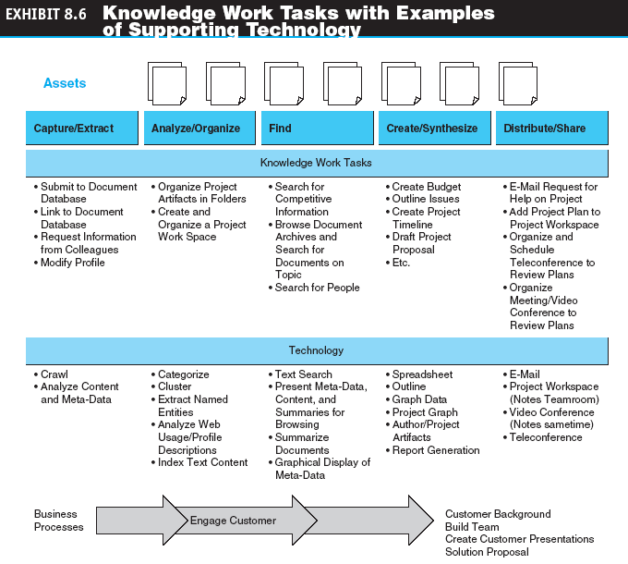
Knowledge Management and E-Commerce

Slide 37
Knowledge Management and E-Commerce
Online Advice and Consulting
  Medical advice
  Management consulting
  Legal advice
  Gurus and answers to queries
  Financial advice
  Other advisory services

Slide 38
Knowledge Management and E-Commerce
Employees’ Knowledge Networks and Expert Advice within Organizations
  expert location systems
  Interactive computerized systems that help employees find and connect with colleagues who have expertise required for specific problems—whether they are across the country or across the room—in order to solve specific, critical business problems in seconds

Slide 39
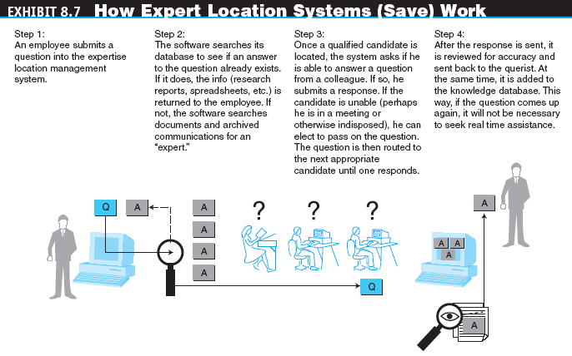
Knowledge Management and E-Commerce

Slide 40
Knowledge Management and E-Commerce
desktop search
Search tools that search the contents of a user’s or organization’s computer files rather than searching the Internet. The emphasis is on finding all the information that is available on the user’s PC, including Web browser histories, e-mail archives, and word-processor documents, as well as in all internal files and databases

Slide 41
Customer-to-Customer E-Commerce
customer-to-customer (C2C)
E-commerce model in which consumers sell directly to other consumers
C2C Auctions
Classified Ads
Personal Services
C2C Exchanges
Selling Virtual Properties
Support Services for C2C

Slide 42
Peer-to-Peer
Networks and Applications
peer-to-peer (P2P)
A network architecture in which workstations (or PCs) share data and processing with each other directly rather than through a central server; can be used in C2C, B2B, and B2C e-commerce

Slide 43
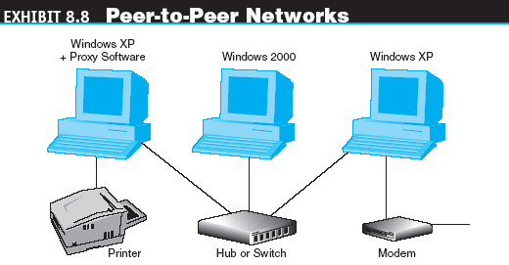
Peer-to-Peer
Networks and Applications

Slide 44
Peer-to-Peer
Networks and Applications
Models of P2P Applications
  Collaboration
  Content distribution
  Business process automation
  Distributed search

Slide 45
Peer-to-Peer
Networks and Applications
C2C P2P Applications
  Napster—the file-sharing utility
  Other file-sharing programs
  Other commercial P2P applications in C2C
    Lending
    Bartering

Slide 46
Peer-to-Peer
Networks and Applications
Intrabusiness P2P Applications
B2B P2P Applications
  Groove Networks
  Hilgraeve’ ChopChute
  Biz2Peer
  Blue Tiger Networks
  Consilient
B2C P2P Applications

Slide 47
Managerial Issues
Can we blog for business?
Are there e-learning and e-training opportunities?
Can we capitalize on C2C?
How well are we managing our knowledge?
What are the e-government opportunities?

